Slide 1

2017 NSBE Hackathon
Team gNET
Names

Slide 2
School
City
Major
Email
Extension
Storage Database
Request
Store
Filter
Student
Recruiter
Chat
Google+

Slide 3


NET+

Slide 4
Front End

Slide 5
Push/Pull

Slide 6
Back End

Slide 7
Test

Slide 8
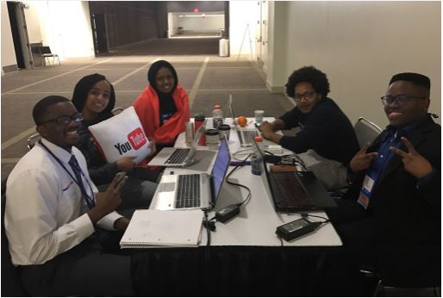

Slide 9
Thank You!!

Slide 10
Questions?

